Slide 1



Slide 2

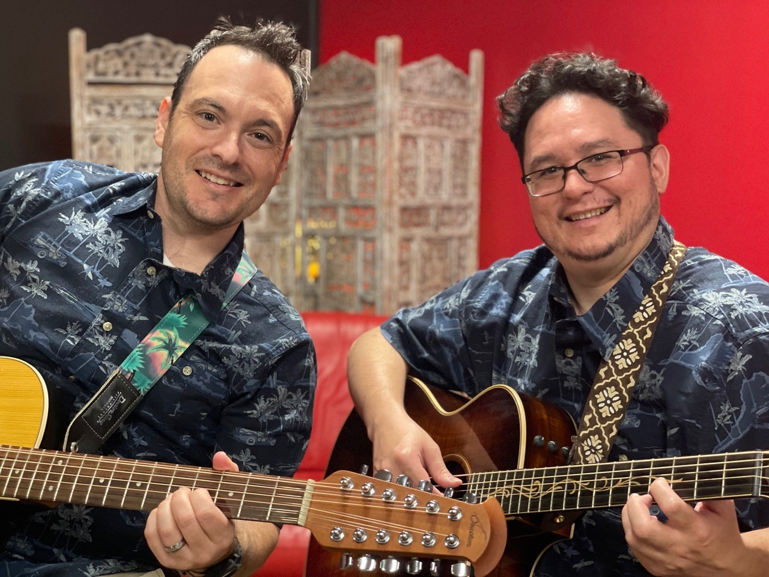
Aloha and Welcome!
Special thanks to the Jamul Casino for their generous support of this event- and to their wonderful chef and staff.
We also thank Slack Key Ohana for bringing us
sounds of Hawaii. They’ll be back right after our
presentation with music to dance beneath the stars!

Slide 3




We also thank these major sponsors:

Slide 4

Plus we express gratitude to our auction and raffle prize donors:
Cal Coast Credit Union Open Air Theatre
at SDSU
Costco
Crafted Greens
Dulzura Winery
Hatfield Creek Winery
Hornblower Cruises
Jamul Casino
Jonathan Goetz
Gypsy Treasures
Lily’s Salon
Nainsook Gallery + Art
Outback Steakhouse
Renee Owens, photographer
Pick up Stix
Prete-a-Porter Salon and Spa
Renee Owens
Samantha’s Boutique
San Pasqual Winery
Snow Valley Resort
Soapy Joe’s Car Wash
Village Rock Shop
Vineyard Grant James
Visionary Dance Theatre
Carol Wei
Yasakuchi Farms

Slide 5

The past year has been challenging for us all.
Our reporting team has been there to cover vital news
across our region including:
Reporting on the COVID-19 pandemic, providing accurate
health news, vaccine info, and relief programs.
Highlighting impacts on vulnerable communities such as
minorities, refugees, the homeless and local businesses.
Covering elections and hosting virtual candidate forums.
Organizing virtual events with speakers on hot topics.
Being on scene for breaking news such as wildfires,
racial justice protests, the La Mesa riot, and more.
Investigative reporting, land use and environmental issues.
Traveling to East County’s cities, rural, desert and mountain
areas reporting news in the public interest.

Slide 6

Our reporting has made a positive difference!
When we reported that a COVID-relief program excluded all businesses in unincorporated areas by requiring business licenses (which the County quit issuing years ago), supervisors changed the rule the next day, helping many local businesses qualify for help.
Our reports on COVID inequities in Latino communities helped fuel improved outreach and steps to protect health of vulnerable people.
Our guide to local farms and restaurants enabled the public to support these local businesses hit hard by shutdowns.
When closure of crowded urban bars threatened our region’s wine industry, our inquiry led to reopening of rural outdoor wineries, which had no COVID cases.
We started a local COVID-19 resource center to help our readers.

Slide 7

Despite challenges, we’ve grown!
Our readership doubled during the COVID lockdown.
We now average 12 million hits and a half million visits every month!
We received a Facebook Journalism Grant to help us survive in 2020, but now we’re relying on our loyal readers to sustain us for the future.
We also picked up more awards, bringing our total of major journalism awards to 126 since we started in 2008.

Slide 8

Tonight we salute our Community Champions
These are heroes among us – people who gave selflessly to help others amid these most challenging times. Please give them all a big round of applause!
Finalists, please come forward to accept your awards when your category is called and remain up front for a group photo.

Slide 9
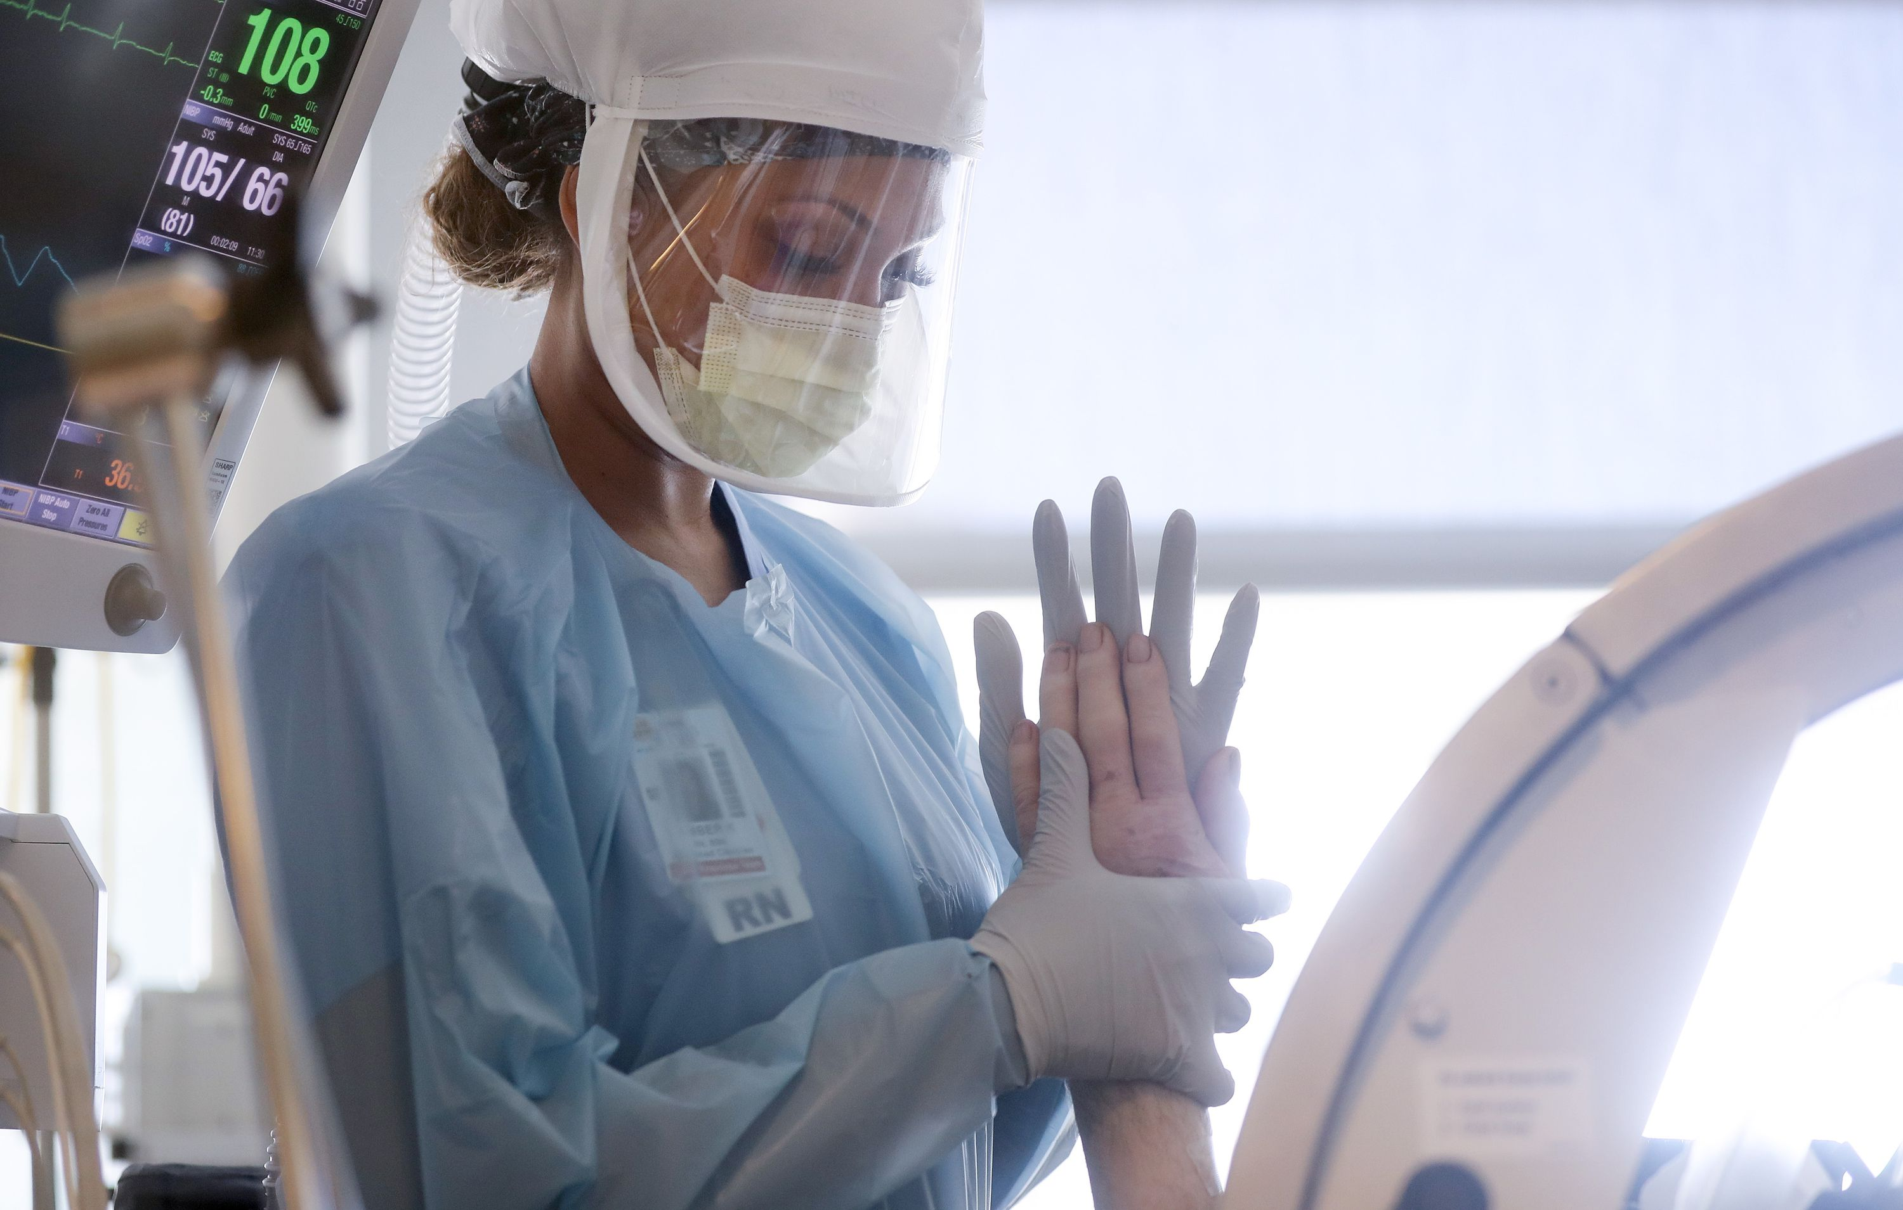
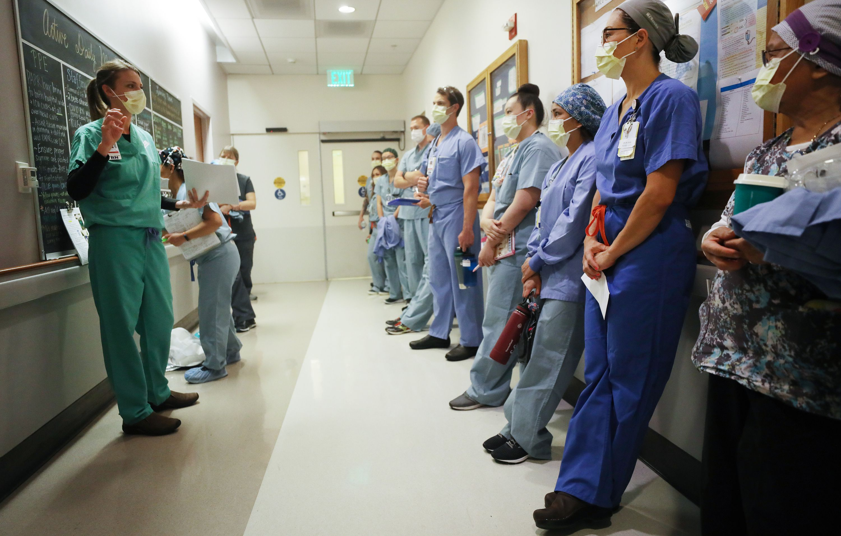
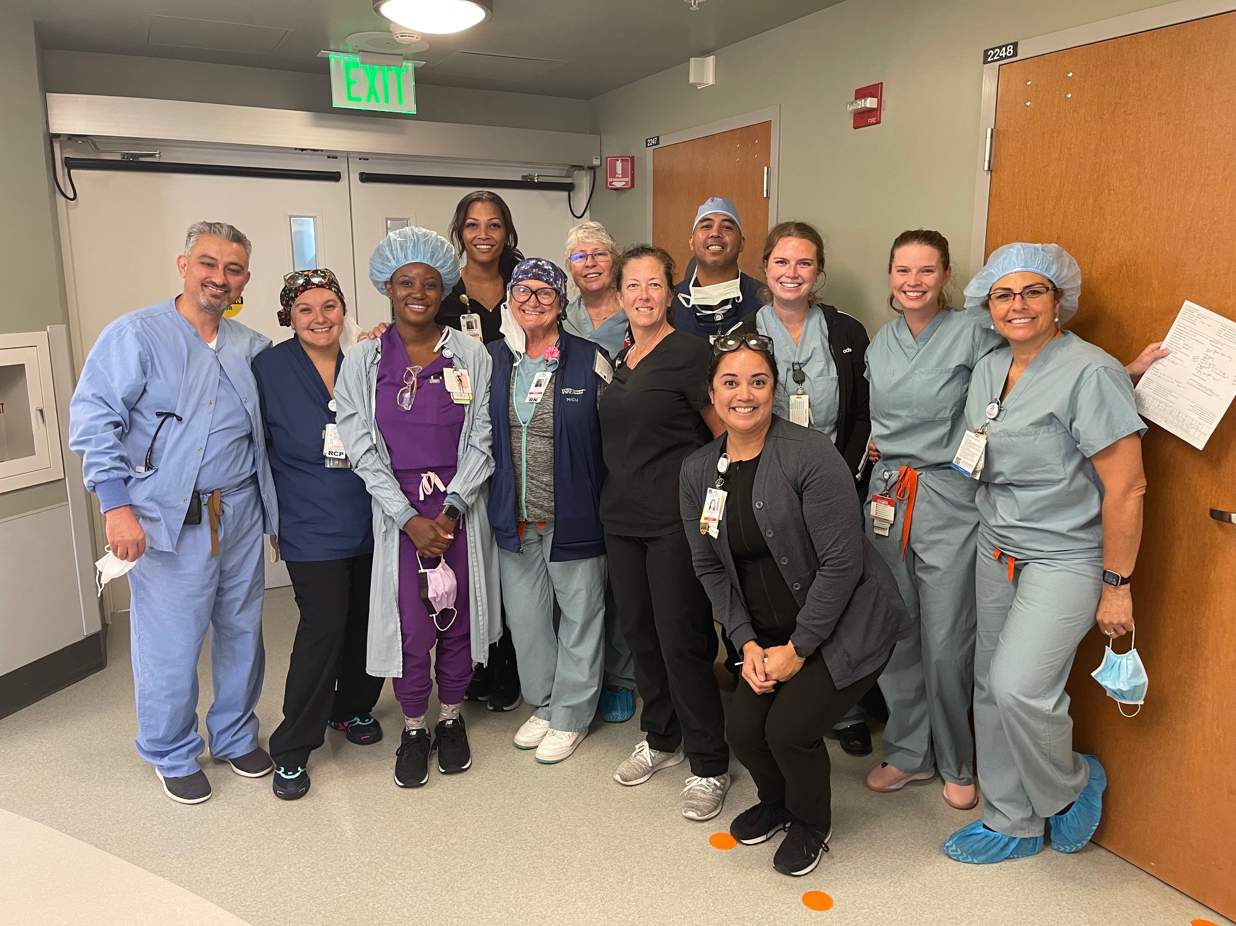
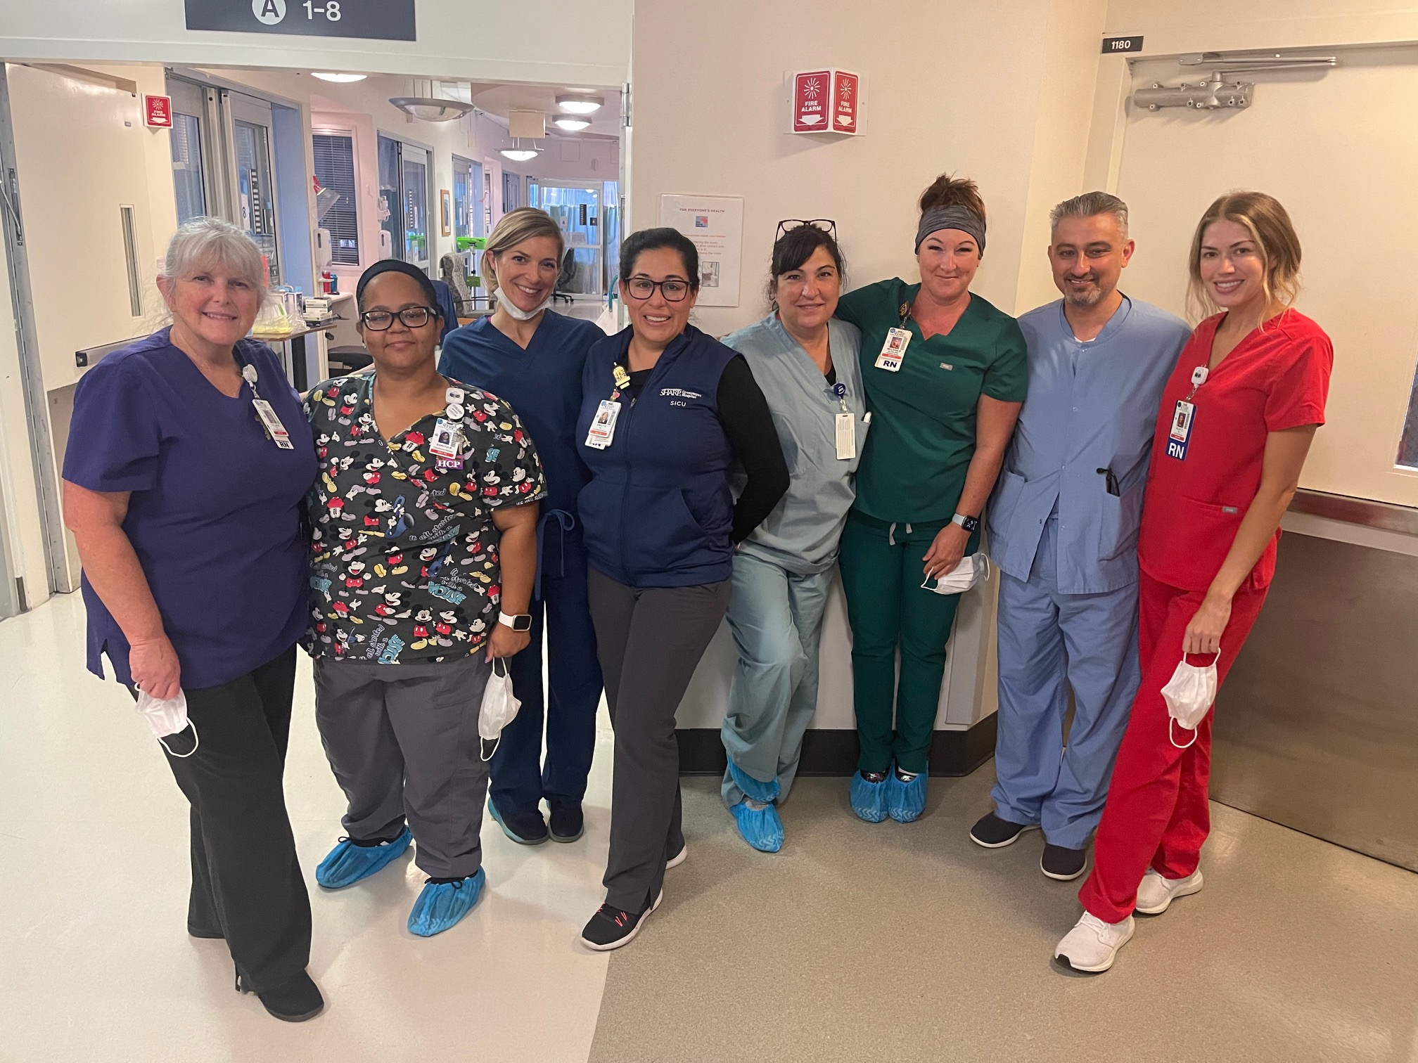
Healthcare Champions
Sharp-Grossmont Healthcare ICU team

Slide 10
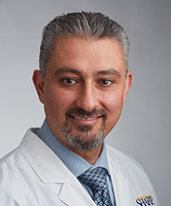
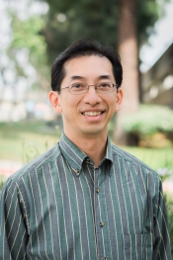
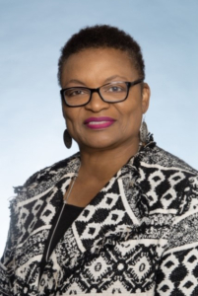
Healthcare Honorable Mentions
Dr. Raed Al-Naser Dr. William Tseng Dr. Wilma Wooten
Sharp-Grossmont Hospital Kaiser Permanente County Public Health Director

Slide 11
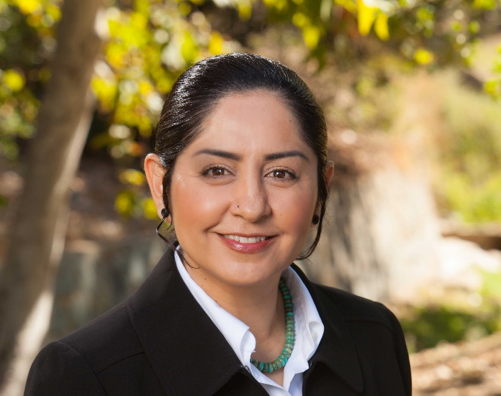
Special Award:
Community Benefactor Champion
Erica Pinto, Chairwoman, Jamul Indian Village

Slide 12
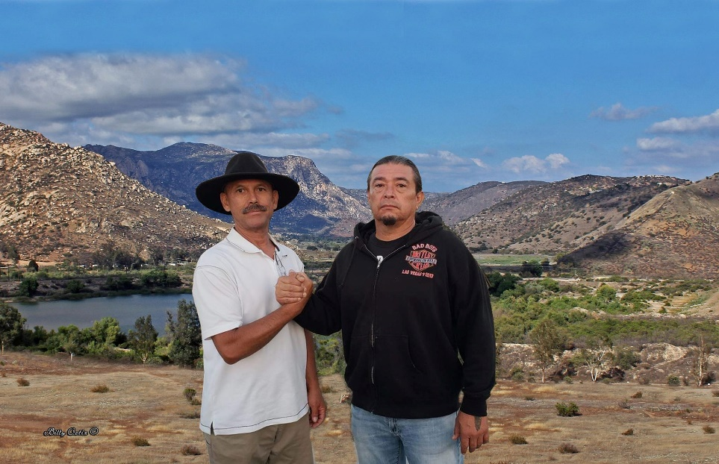
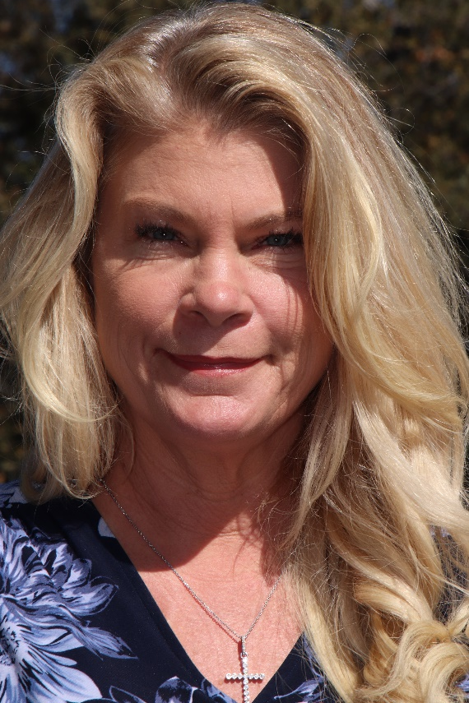
Environmental and Wildlife Protection Champions
Billy Ortiz and Bobby Wallace, Bobbi Brink, Lions, Tigers & Bears
Environmental Champions Wildlife Champion

Slide 13
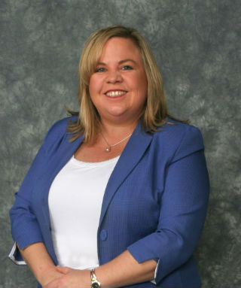
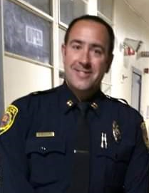
Public Safety Champions
Kathleen Coates-Hedberg,
Grossmont-Mt. Helix Improvement Association
Captain Mike Nicholass,
La Mesa Police Department

Slide 14
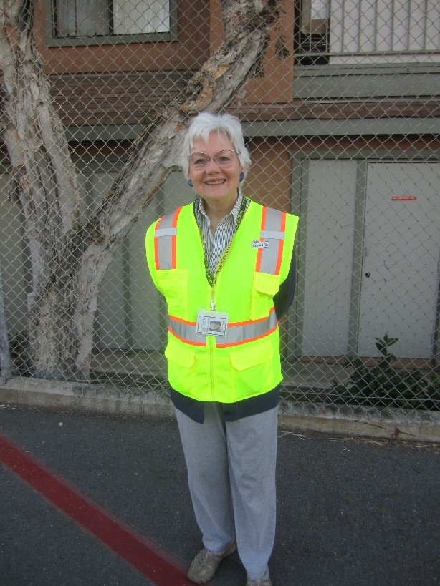
Public Safety Honorable Mention
Carol Lockwood,
La Mesa Safe Routes to School Volunteer

Slide 15
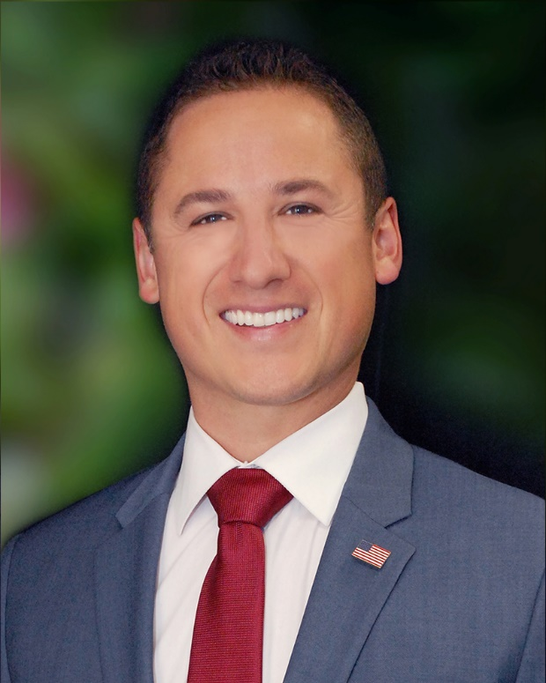
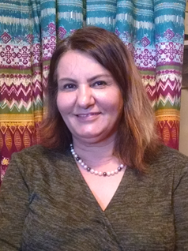
Humanitarian Champions
El Cajon Councilman Phil Ortiz,
Rebuild La Mesa Fund organizer
Dilkhwaz Ahmed,
License to Freedom

Slide 16
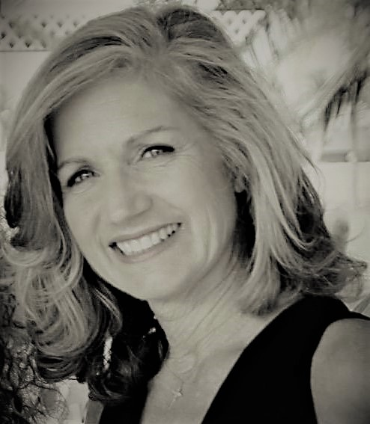
Humanitarian Honorable Mention
Anna Marie Piconi Snyder,
You Did It For Me, Inc.

Slide 17
Briana Gomez Award for Racial and Social Justice
In memory of the late Briana Gomez, East County Magazine’s beloved multi-cultural journalist, to honor racial and social justice champions

Slide 18
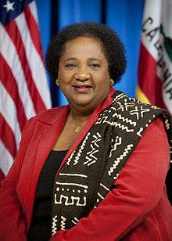
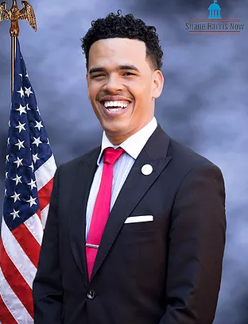
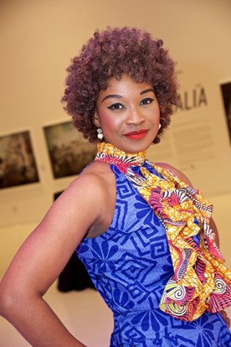
Briana Gomez
Racial and Social Justice Champions
Shirley Weber, PhD Rev. Shane Harris, Buki Domingos,
Calif. Secretary of State People’s Alliance for Advocate for victims
Justice Advocates of human trafficking

Slide 19
Our honored speaker tonight is California Secretary of State Shirley Weber, Ph.D.
The daughter of sharecroppers in Arkansas during the segregationist Jim Crow Era, Dr Weber is an American success story. She also knows first-hand the importance of civil rights and voting rights.
Her grandfather never voted due to laws that suppressed voting by Blacks. Her father left Arkansas after he was threatened by a lynch mob and could not vote until he was in his 30s.
Raised in California since age 3, Dr. Weber earned her Ph.D. degree by age 26. She taught at colleges including SDSU, where she retired as chair of the Department of Africana Studies. She also served as chair of the San Diego Unified School District.
Elected to represent California’s 79th Assembly district, she was a powerhouse in the Legislature. She chaired the California Legislative Black Caucus and chaired many committees including the Assembly Budget Committee, the Elections and Redistricting Committee, a committee to address hate crimes on campuses, a subcommittee on public safety, and a committee on Higher Education in San Diego County to improve access to affordable higher education.
Her legislative accomplishments include major reforms in criminal justice and education, improving transparency and reporting on police use of force incidents, addressing racial profiling, predatory lending, inclusive jury selection, ethnic studies, restorative justice, health reforms, and legislation to help senior citizens, veterans and military families.
She has a passion for equality and fairness--and has fought tirelessly to expand civil rights for all Californians.
In January, she became California’s first Black Secretary of State, where she is now working to protect voting access for us all.

Slide 20
We are pleased to announce the
Briana Gomez Multicultural Journalism Fund
This fund will help mentor and train young journalists in multicultural reporting and continue Briana’s legacy.
Briana was passionate about telling the stories of people in San Diego’s diverse communities including Latinos, Arab-Americans, Jewish residents, Native Americans, Asian-Americans, African-Americans, refugees, immigrants, and more. She was dedicated to covering all sides on issues fairly and in depth, with sensitivity and respect toward all.
Please go to www.EastCountyMedia.org/donate if you wish to donate to the new Briana Gomez Multicultural Journalism Fund.
Or give to our general fund to support all local news coverage, or to our wildfire and emergency alerts fund. Consider a sustaining monthly pledge – the lifeblood that sustains community journalism!

Slide 21
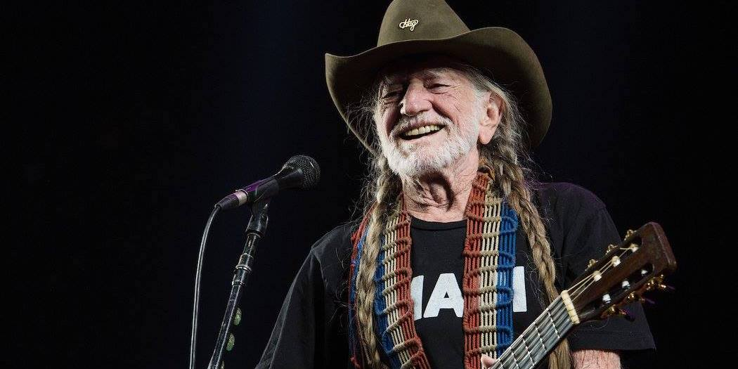
Special Announcements
Our first silent auction table will close 10 minutes after our presentations.
The second silent auction table will close bidding 15 minutes after our presentations.
Our raffle includes a very special prize just added (and not listed in your program):
4 tickets to legendary country music star Willie Nelson’s Outlaw Music Festival at SDSU! ( a $560 value)
Drop your tickets in the boxes for the raffle items you’d like to win.
It’s not to late to buy more raffle tickets! Final drawing will be after the silent auction closes. Winners will be posted on the white board by the auction and raffle tables.

Slide 22


Visit our news site!
Contact us:
editor@eastcountymagazine.org
(619)698-7617
Funded by the nonprofit 501(c)3 East County Media
Published by the nonprofit 501(c)3 Heartland Coalition

Slide 23
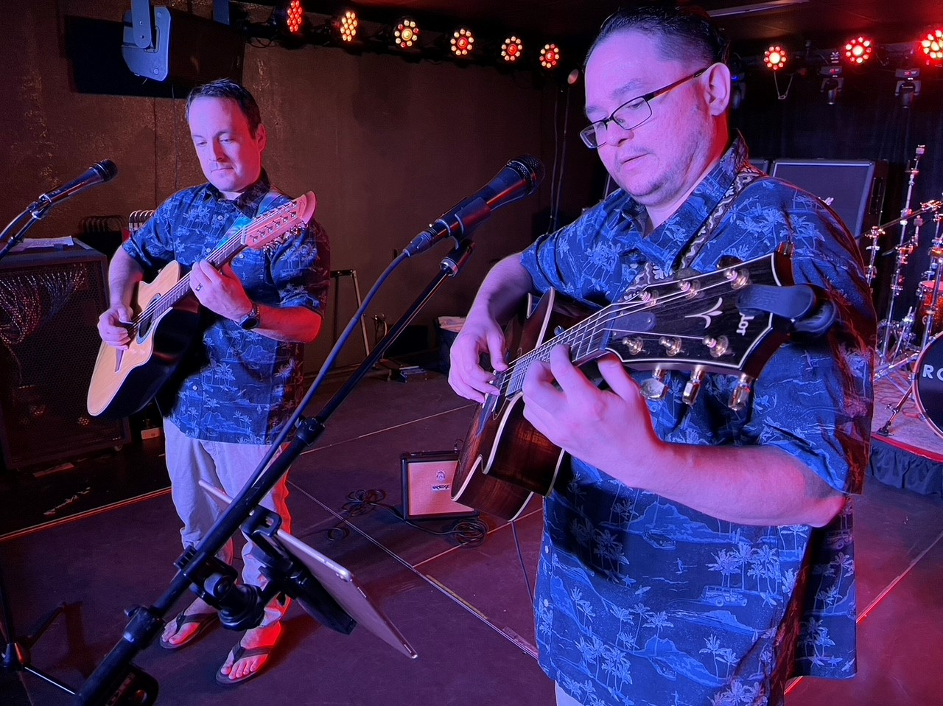
Enjoy more music by Slack Key Ohana.
Let’s dance the night away. Mahalo!

