Slide 1
El Cajon Courtyard
Excel Hotel Group
July 1, 2014

Slide 2
Project Description
Downtown hotel
Four stories – 51 feet high
Commercial retail space
Community room
Café
On-sale alcohol service
Reduced parking
Outdoor eating

Slide 3
Project Facts
Conditional Use Permit regulates development and proposed uses
General Plan advocates mixed-use and urban type development
Parking available in public parking lots and on Rea Avenue
No significant environmental effects
No public comments received

Slide 4
Existing Conditions
Site includes three properties
Surrounding uses include City Hall, Police station, courts, retail and service uses
Public parking available - 676 spaces
On-street parking
Infrastructure and required utilities in place and available

Slide 5
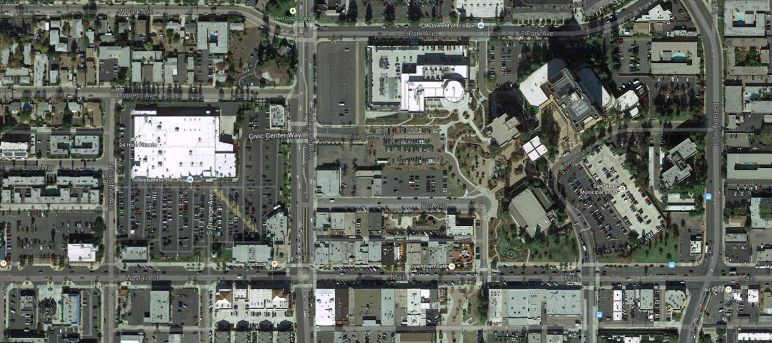
Aerial
120 Public Parking Spaces
83 Public Parking Spaces
Subject Site
405 Public Parking Spaces
40 Public Parking Spaces
28 Public Parking Spaces

Slide 6
Project Land Use & Design
Multiple Planned Uses
  120 rooms
  Commercial lease opportunities
  Café with outdoor dining
  On-sale alcohol service
  Available community room space
Exceptional level of architectural quality
Integration with adjacent properties

Slide 7
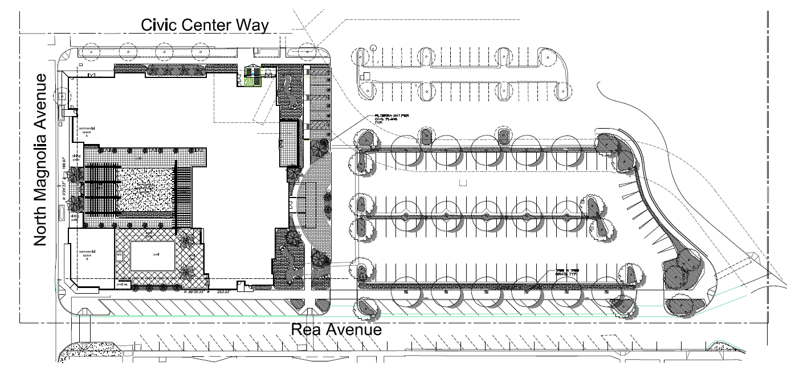
Site Plan

Slide 8
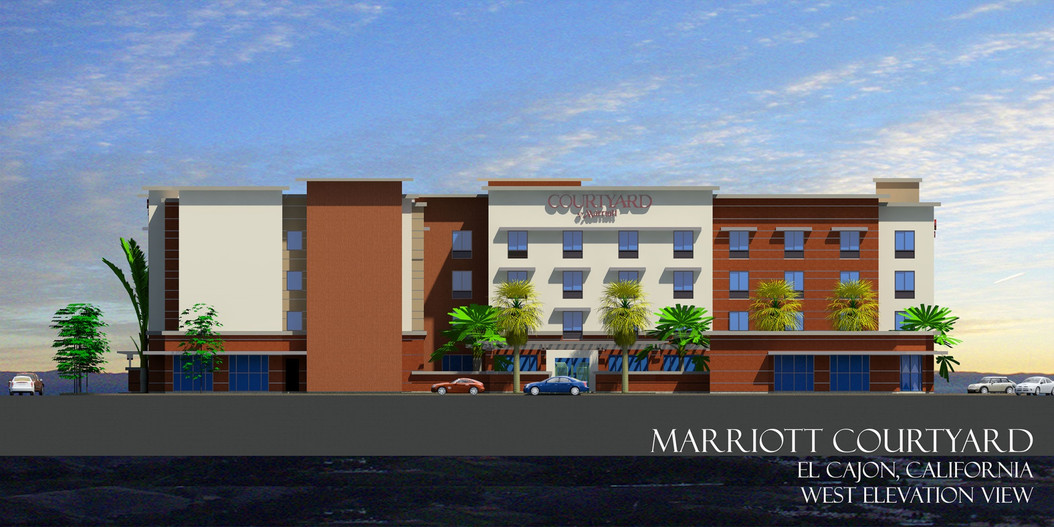
Elevations
Magnolia Avenue View

Slide 9
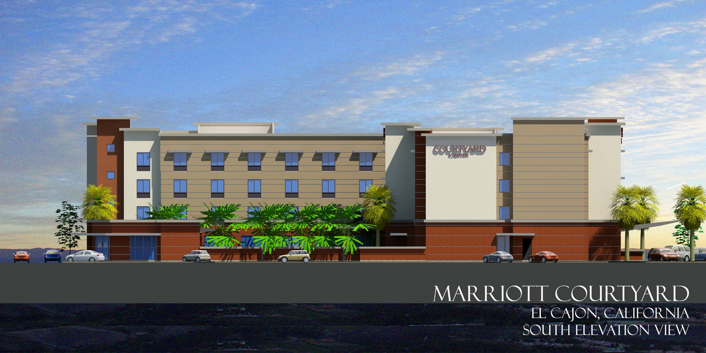
Elevations
Rea Avenue View

Slide 10
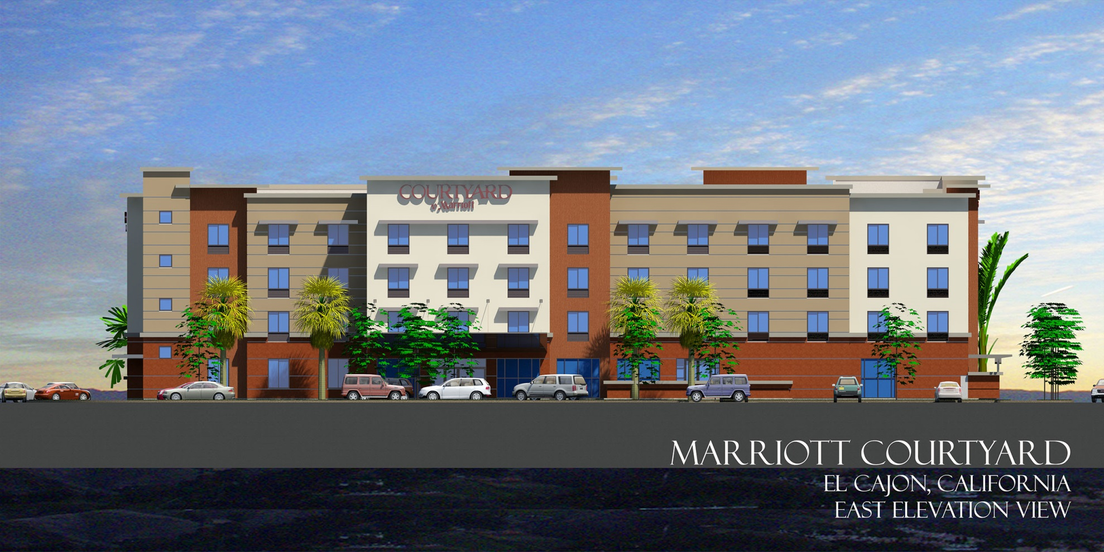
Elevations
City Hall View

Slide 11
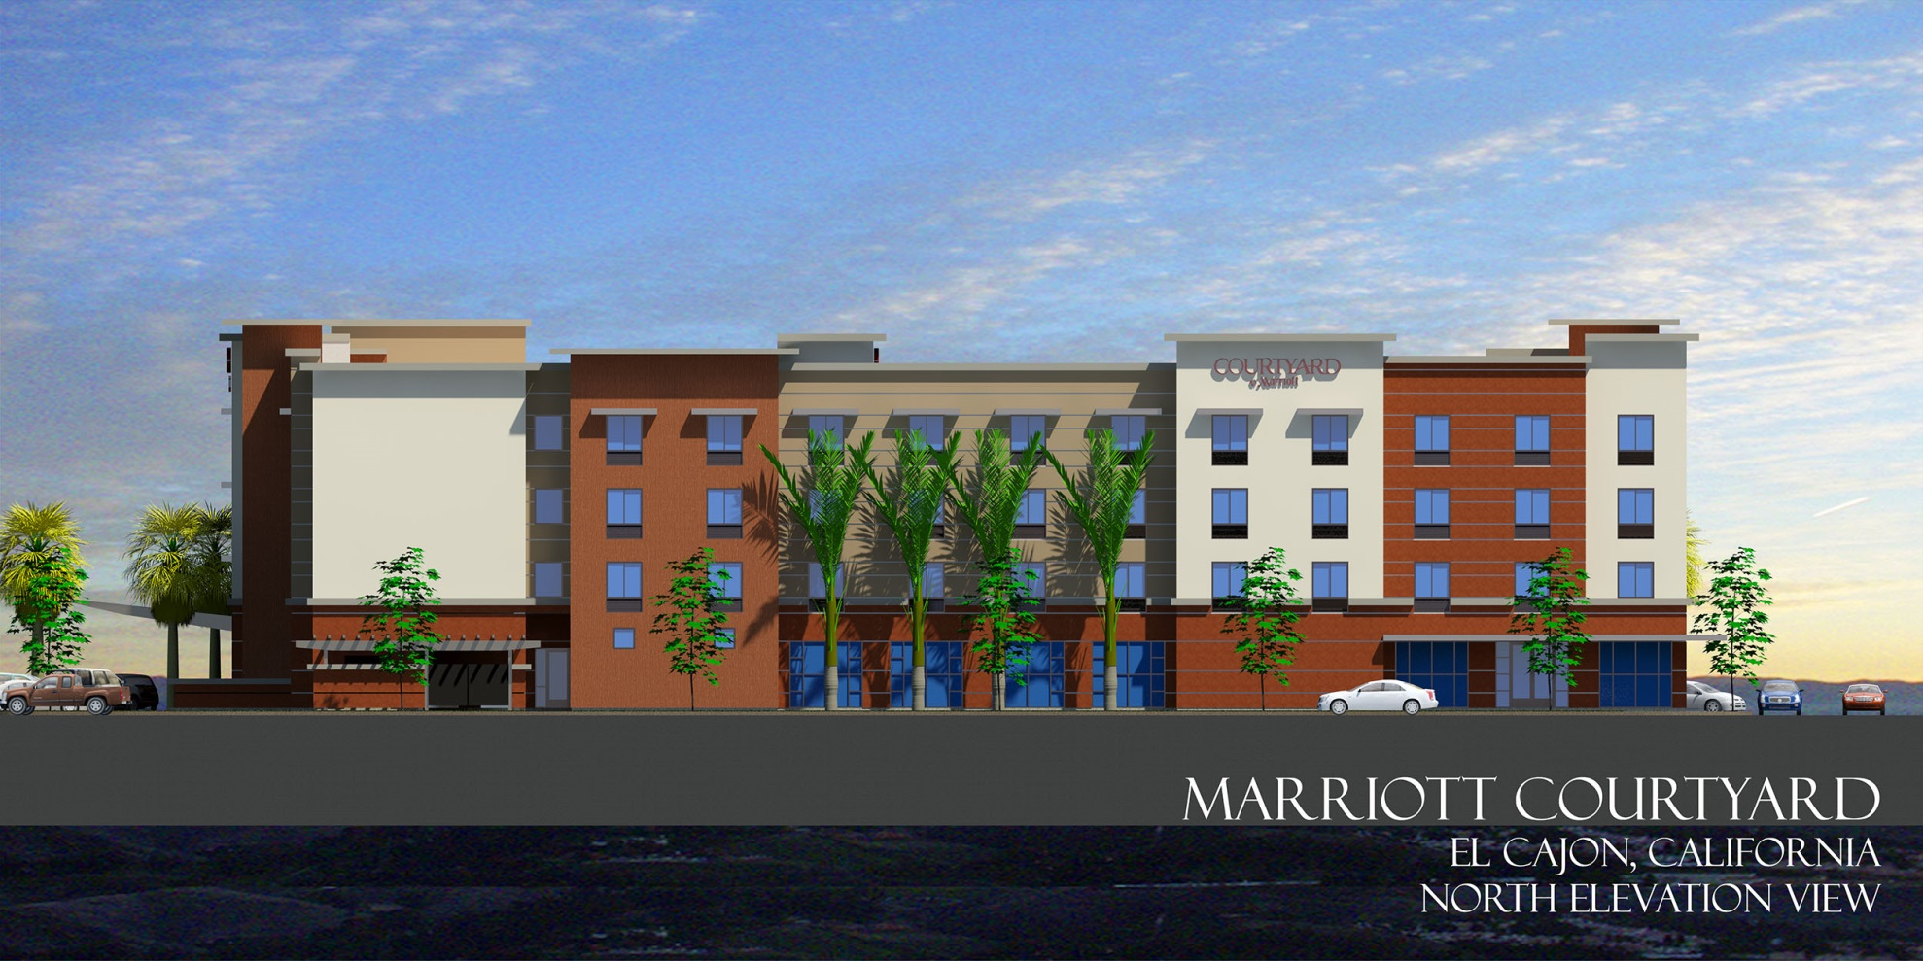
Elevations
Civic Center Way View

Slide 12
General Plan Consistency
Redevelopment Goals & Policies
  Produce economic viability
  Remove vacant underutilized properties
Enhances downtown environment
  Adds to the mixture of uses and activities
  Special Development Area No. 9

Slide 13
Zoning / Regulatory Review
Specific Plan No. 182
  Meets design standards
  Compatible with recent developments
  Parking available while maintaining urban environment
Zoning Code
  On-site alcohol service

Slide 14
CEQA
Categorically exempt per Section 15532
  In-fill development
  Less than 5 acres
  Consistent with General Plan & Zoning
  No habitat value
  No significant effects

Slide 15
Findings Summary
Project implements the General Plan & Specific Plan No. 182
Satisfies applicable use & development standards
Compatible with existing & planned land uses
Conditions of approval designed to ensure public health, safety & general welfare
Redevelops a vacant underutilized site

Slide 16
Recommendation
City Council approval by adoption of the next resolution in order.

Slide 17
Aerial
Subject Site

Slide 18
Aerial
120 Public Parking Spaces
83 Public Parking Spaces
Subject Site
405 Public Parking Spaces
40 Public Parking Spaces
28 Public Parking Spaces

Slide 19
Site Plan

Slide 20
Elevations
Magnolia Avenue View

Slide 21
Elevations
Rea Avenue View

Slide 22
Elevations
City Hall View

Slide 23
Elevations
Civic Center Way View

